Slide 1
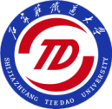
发挥铁路专业特色，服务中俄高铁发展 Take the Railway Characterized Specialty, Serve the Development of High-speed Railway of Sino-Russia
杨绍普
Yang Shaopu
2016.12.1
石家庄铁道大学
SHIJIAZHUANG TIEDAO UNIVERSITY

Slide 2
Part 1
学 校 简 介 STDU Introduction

Slide 3
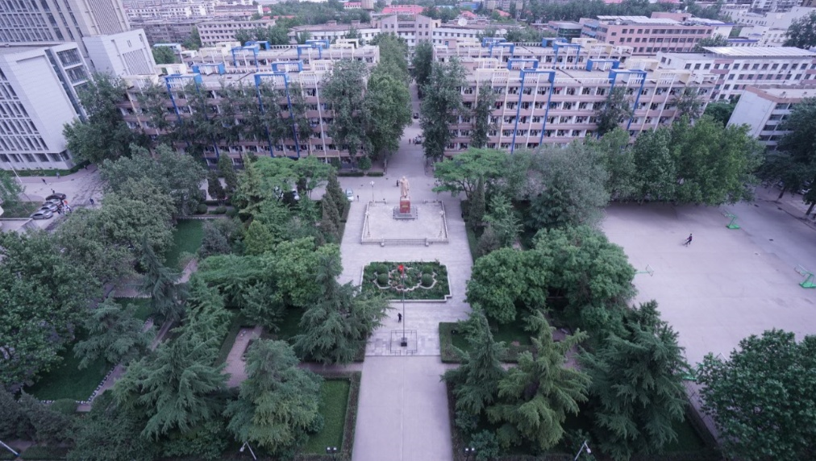
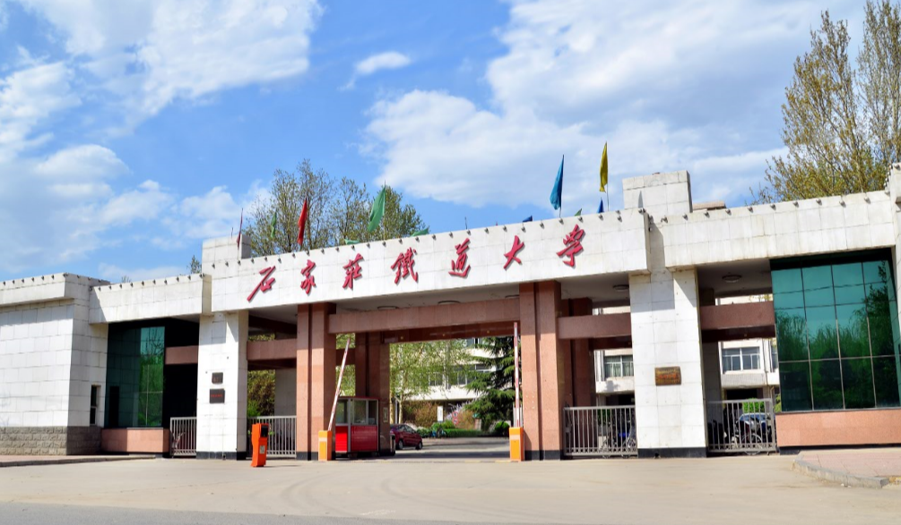
基 本 情 况
General information
石家庄铁道大学是一所以工为主、特色鲜明的工程技术大学。
Shijiazhuang Tiedao University (STDU) is a distinctive technical university with the characteristic of Railway .

Slide 4
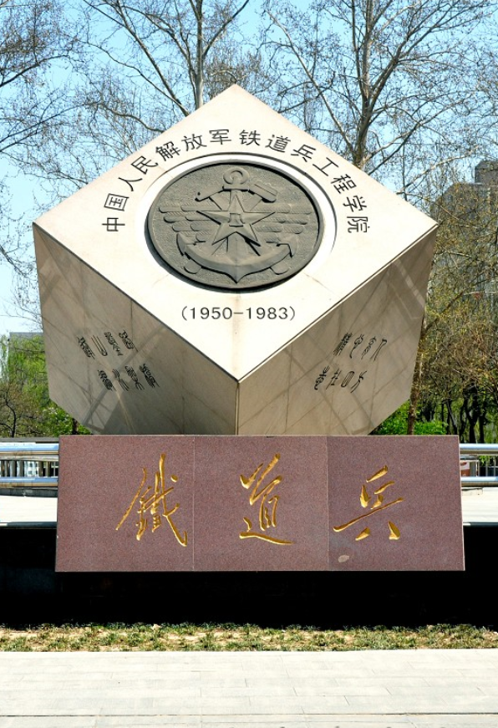
历史沿革
History
创建于1950年，原为中国人民解放军铁道兵工程学院，1984年划归铁道部，2000年转制河北省。现由省政府、国家铁路局、教育部三方共建。
It was established in 1950，formerly the Engineering Institute of Chinese People’s Liberation Army Railway Corps. In 1984, it was put under the administration of the Ministry of Railways, and it came under the jurisdiction of Hebei province in 2000. Now, it is administrated by the three parties----the provincial government, the State Railway Bureau, and the Ministry of Education.

Slide 5
学科专业
Discipline
18
49
44
2
学院
Schools
本科专业
Undergraduate
Majors
硕士学位
Master
Programs
博士学位
Doctor
Programs

Slide 6
教学团队
Teaching Team
中国工程院院士1人，国家级教学团队2个，教育部创新团队1个。
One academician from Chinese Academy of Engineering, 2 National Teaching Groups and 1 Innovation Group named by the Ministry of Education.

Slide 7
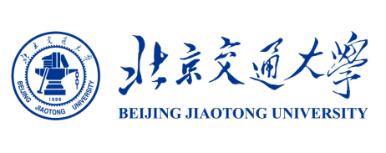
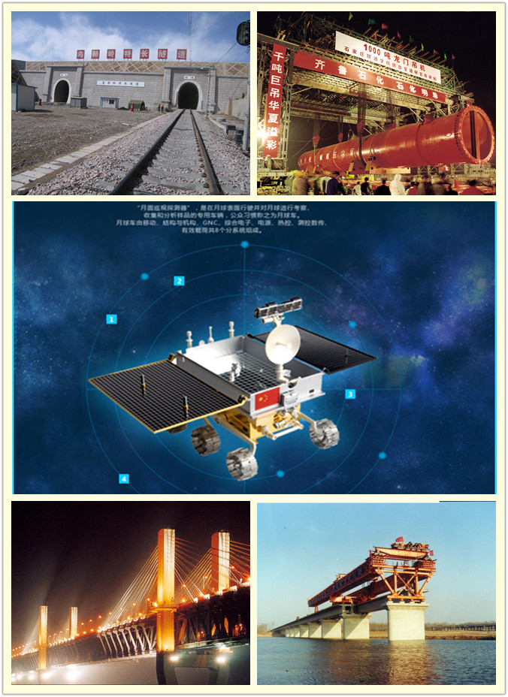
优秀学科群
Several groups of superior specialties
大型结构健康监测与诊断、交通环境与安全工程、国防交通应急工程、长大隧道施工技术及变形控制，航空航天虚拟现实技术及其应用。
Large structural health monitoring and diagnosisthe, traffic environment and safety engineering, emergency projects in national defence transportation, the technique and deformation control in the long and large tunnel engineering, virtual reality technology of Aeronautics and Astroautics.

Slide 8
人 才 培 养
Talent Cultivation
学校培养了近10万余名毕业生，毕业生就业率常年保持在96%以上，大约有60%的毕业生进入中国铁路系统工作。
STDU cultivated more than 100,000 graduates and kept the employment rate over 96%. More than 60% of the graduates enter into the Chinese railway enterprises.

Slide 9
Part 2
与俄罗斯高校的交流与合作情况
The exchanges and cooperation with Russian colleges and universities

Slide 10
远东国立交通大学
Far Eastern State Transport University
2011年2月，双方就开展全面合作签署协议；2012年10月，我校应邀参加对方75周年校庆。
In February,2011,the two parties signed an agreement on comprehensive cooperation;In october,2012,STDU was invited to take part in its 75th anniverary.

Slide 11
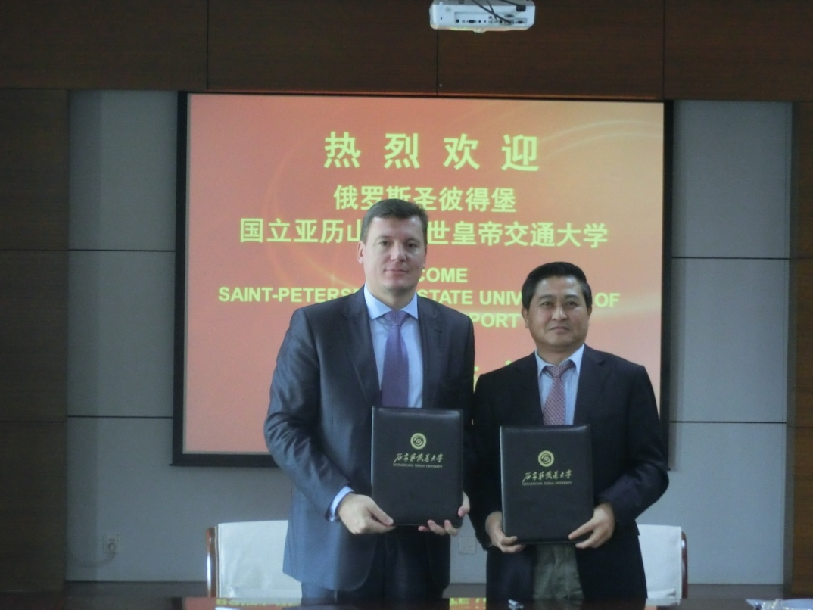
圣彼得堡国立交通大学
Petersburg State Transport University
2014年10月，校长帕内切夫来校访问，双方就铁路技术人才联合培养项目签署了合作协议。
In October, 2014, Pennycheave, the president of the university, visited our university. The two parties signed a cooperative agreement on the joint training projects of railway technical personnel.

Slide 12
欧亚地区交通大学校长论坛
President Forum of Transport Universities in Eurasian Area
我校应邀连续两届参加了欧亚地区交通大学校长论坛暨学术研讨会。会后，乌拉尔国立交通大学副校长来我校交流访问，签署了合作协议。
STDU was invited to attend the traffic university’s President Forum and academic seminar twice in a row. After the meeting, vice president of Ural State University of Railway Transport visited our university and signed a cooperative agreement.

Slide 13
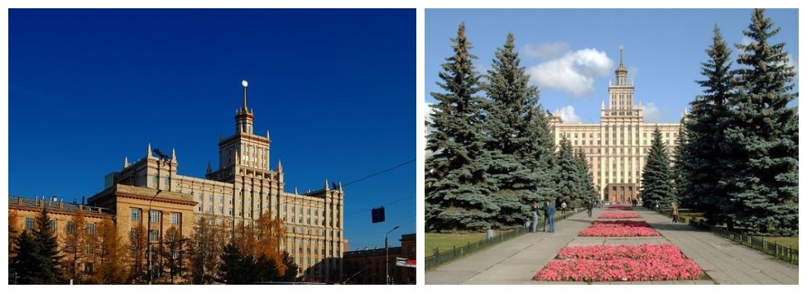
南乌拉尔国立大学
South Ural State University
2014年12月，副校长塔赤科夫来校访问，双方就在我校开设普希金学院事宜达成协议。
In December 2014, Tuchcoug the vice President of South Ural State University, visited our university. The two parties have come to an agreement on opening Pushkin College in our university.

Slide 14
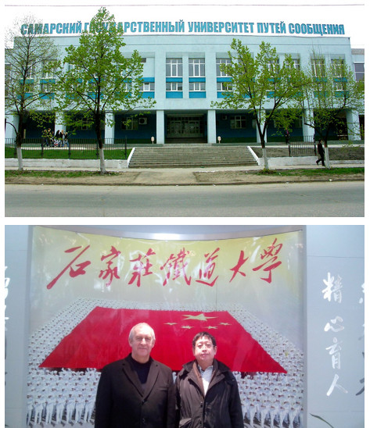
萨马拉国立交通大学
Samara State Communication University of Russia
2013年12月，副校长瓦列里来校访问，双方就学生交流、合作办学、教师培训等方面进行了交流，并签署了合作协议。
In December, 2013, Valery, the vice President of the university, came to visit our university. The two universities had communications on many aspects such as students’ exchange, joint school-running and teachers’ training and so on, and finally signed a cooperative agreement.

Slide 15
伊尔库茨克国立交通大学
Irkutsk State Transport University
2016年1月，校长安德烈来校访问，双方就学生交换、教师互访等方面进行了交流，并签署了合作协议。
In January 2016, Andre, the university’s President, visited our university. The two sides had communications on many aspects such as students’ exchange, teachers visiting and other aspects, and signed a cooperative agreement.

Slide 16
在“一带一路”建设中的合作计划
The Cooperative Program in the Construction of “One Belt and One Road”
Part 3

Slide 17
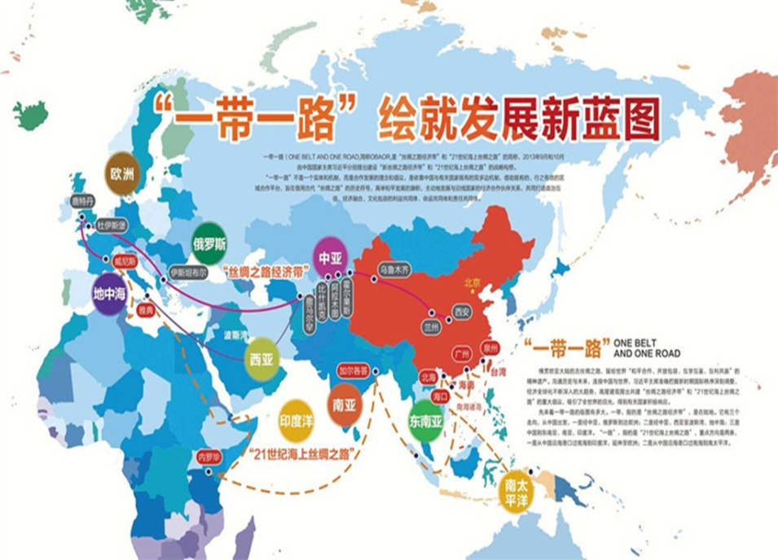
学校围绕一带一路和高铁走出去战略，加强与俄罗斯高校的合作交流。
Based on “One Belt and One Road” and “High-speed Rail Going Out” strategies, STDU will strengthen exchange and cooperation with Russian.

Slide 18
共同培养既精通专业又掌握俄语的工程技术人才，为两国在铁路交通领域合作提供人才和技术支持。
Cultivate the engineering and technical talents who are not only proficient in their major but master Russian and provide professional talents and technical support for bilateral cooperation in the field of railway transportation.
合作办学
Joint school-running
重点为中俄合作办学机构开展俄语教学，培养精通俄语的铁路专业技术人才。
The center will focus on carrying out Russian teaching for the institution of Sino-Russian joint school-running and training technical personnel of railway specialty who are proficient in Russian.
人文交流项目
Humanities
exchanges
program

Slide 19
科研合作Scientific research cooperation
进一步加强校际教师互访和教学、科研等方面的合作，为学生创造交流学习平台，促进学校教育的国际化。
Further strengthen intercollegiate mutual visits of teachers and teaching, scientific research and other aspects of cooperation in order to create a platform for students’ learning, so as to promote internationalization of school education.
铁路人才培训 Railway personnel training
积极参与国家铁路局、商务部双边、多边合作项目的实施。
Actively carry out these projects of National Railway Administration, and bilateral and multilateral cooperation of the Ministry of Commerce.

Slide 20
期待与您的合作
谢谢!
Looking forward to our cooperation
Thanks!
石家庄铁道大学
SHIJIAZHUANG TIEDAO UNIVERSITY

